Slide 1

DEFAULT IMPUTATION EFFICIENCY COMPARISION
Presented by Jakub Wiśniewski

Slide 2


WHAT ARE MISSING VALUES?
Why is an imputation important to us?
Warsztaty Badawcze | Grupa PaRenKuKu ds. Imputacji Danych

Slide 3
SUMMARY OF CONTENTS
OUR MAIN TOPIC OF PRESENTATION
METHODOLOGY
EXPERIMENT
RESULTS
CONCLUSIONS
Imputing strategies
Metrics
Classification algorithms
Datasets
Experiment workflow
Ranking of imputation methods
Time of imputation
Summary and conclusions of the results
Warsztaty Badawcze | Grupa PaRenKuKu ds. Imputacji Danych

Slide 4

NAIVE APPROACH
OUR IMPUTING STRATEGIES
removing columns with missing values
imputing with random values from given feature
imputing with median (for numerical features) and mode (for categorical features)
NINE DIFFERENT METHODS
MORE ADVANCED APPROACH
Random Forest from missForest package
KNN from VIM package
hot-deck algorithm from VIM package
Iterative Robust Model-Based Imputation (IRMI) from VIM package
predictive mean matching (pmm) from mice package
classification and regression trees (cart) from mice package
Warsztaty Badawcze | Grupa PaRenKuKu ds. Imputacji Danych

Slide 5
SELECTED CLASSIFICATION MODELS
CLASSIFICATION ALGORITHMS
Bagged CART (treebag)
Random Forest (ranger)
Multivariate Adaptive Regression Spline (earth)
k-Nearest Neighbors (knn)
Naive Bayes (nb)
AND METRICS USED TO EVALUATE OUR MODELS PERFORMANCE
WE USED FOUR METRICS THAT ARE GOOD FOR IMBALANCED DATA
AUC
Balanced Accuracy
Geometric Mean
Weighted TPR-TNR
Warsztaty Badawcze | Grupa PaRenKuKu ds. Imputacji Danych

Slide 6
EXPERIMENT WORKFLOW
DATASET WITH MISSING VALUES
We used 11 different datasets from OpenML. Our experiment consists of three modules:
choosing and spliting datasets
imputing
training, testinf and evaluating
INTERPRETING RESULTS
TRAIN TEST SPLITING (80/20)
if did not work skip to next imputation method
IMPUTING TRAIN SET
TRAINING ML ALGORITHM
encoding/normalising if needed
CHOOSING IMPUTATION METHOD
EVALUATING WITH METRICS
IMPUTING TEST SET
PREDICTING
encoding/normalising if needed
Warsztaty Badawcze | Grupa PaRenKuKu ds. Imputacji Danych
Warsztaty Badawcze | Grupa PaRenKuKu ds. Imputacji Danych

Slide 7
RANKING OF IMPUTATION METHODS
TOP 3 BEST IMPUTATIONS
TOP 3 WORST IMPUTATIONS
ranger:
vim knn
missForest
pmm (mice)
earth:
random fill
median and mode
cart (mice)
treebag:
random fill
cart (mice)
median and mode
knn:
missForest
random fill
median and mode
nb:
random fill
vim knn
missForest
ranger:
vim hotdeck
vim irmi
remove columns
earth:
pmm (mice)
vim irmi
remove columns
treebag:
vim knn
vim irmi
remove columns
knn:
vim irmi
pmm (mice)
remove columns
nb:
cart (mice)
vim irmi
remove columns
Presentations are communication tools that can be used as demonstrations, lectures, speeches, reports, and more.
Warsztaty Badawcze | Grupa PaRenKuKu ds. Imputacji Danych

Slide 8
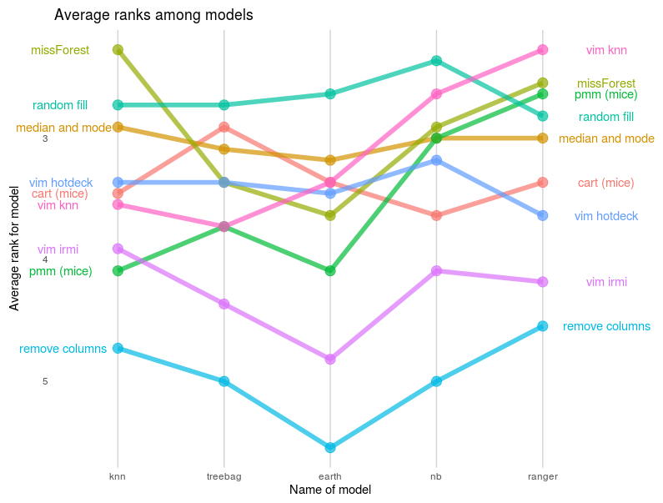
RANKING OF IMPUTATION METHODS
Warsztaty Badawcze | Grupa PaRenKuKu ds. Imputacji Danych

Slide 9
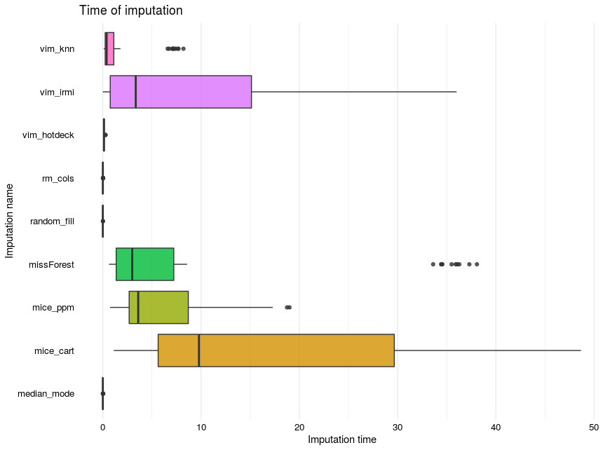
TIME OF IMPUTATION
Warsztaty Badawcze | Grupa PaRenKuKu ds. Imputacji Danych

Slide 10
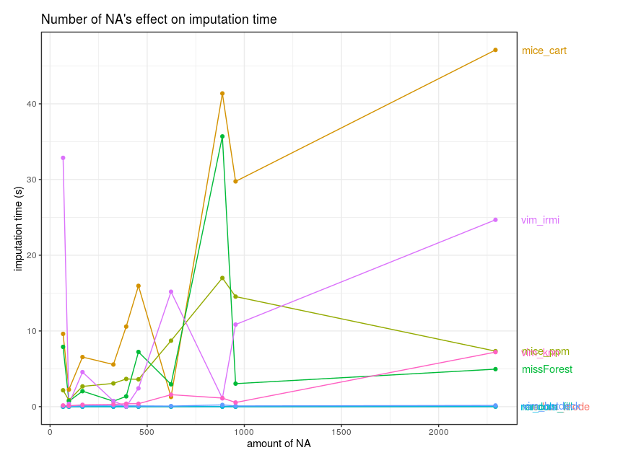
TIME OF IMPUTATION
Warsztaty Badawcze | Grupa PaRenKuKu ds. Imputacji Danych

Slide 11
SUMMARY AND CONCLUSION
Warsztaty Badawcze | Grupa PaRenKuKu ds. Imputacji Danych

Slide 12
QUESTIONS? COMMENTS?
LET US KNOW!

